Slide 1

Software Engineering
The application of systematic, disciplined, quantifiable approach to the development, operation, and maintenance of software, that is the application of engineering to software
- IEEE

Slide 2
ACM/IEEE Code of Ethics
(available at http://www.acm.org/serving/se/code.htm)
• PUBLIC: Act consistently with
the public interest
• CLIENT AND EMPLOYER: Act
in the best interest of client and
employer, consistent with the
public interest
• PRODUCT: Ensure product
meets highest professional
standards
• JUDGMENT: Maintain integrity
and independence in
professional judgment
• MANAGEMENT: Managers
and leaders should promote an
ethical approach to the
management of software
development
• PROFESSION: Advance the
integrity and reputation of the
profession
• COLLEAGUES: Be fair and
supportive of colleagues
• SELF: Participate in lifelong
learning, promote ethical
approach to the profession

Slide 3
Software is not
what we think it is
Software != Code
Source code is a subset software project
Requirements and specification
Design documents
Test suites, test plans
Interfaces
Documentation

Slide 4
Large software is not
what we think it is
Large Software != Lots of Code
Large software brings up several issues of scale:
• Total comprehensibility must be forfeited
• Solo programming becomes impossible
• Communication becomes an essential challenge
• Changing requirements are an everyday reality
• Lifetime is measured in years or decades
• People don’t know what they want

Slide 5
Software as a Product
Software is expensive!
The major cost is your salary!
Every software project has a trade-off between:
Functionality
Resources (cost)
Timeliness

Slide 6
Client (a.k.a. Customer)
❖ The client provides resources and expects some product in return.
❖ Client satisfaction is the primary measurement of success.
Question: Who is the client for Microsoft Excel?

Slide 7
Variety of Software Products
Examples
Real time: air traffic control
Embedded systems: digital camera, GPS
Data processing: telephone billing, pensions
Information systems: web sites, digital libraries
Sensors: weather data
System software: operating systems, compilers
Communications: routers, mobile telephones
Offices: word processing, video conferences
Scientific: simulations, weather forecasting
Graphical: film making

Slide 8
Qualities of A Good Software
Usability - user-friendliness; ease of use
Maintainability – adaptable to change of requirement
Dependability – accurate; deliver what it has promised
Efficiency – does not consume system resources

Slide 9
Additional Software Qualities (Developers Perspective)
• Modularization
• Reliability
• Robustness
• Flexibility
• Good internal documentation
• Good external documentation

Slide 10
Ideal Goals of Software Engineering
Correctness - no errors
Usefulness- does what we want to do
Minimal production effort
minimal cost;
minimal time;
maximum profit;
minimal maintenance effort;

Slide 11
Categories of Software Product
Generic (e.g., Microsoft Excel)
Bespoke (customized) (e.g., IRS internal system)
Many systems are customized versions of generic packages (e.g., Cornell's payroll system)

Slide 12
Variety of Software Products
Software products are very varied
--> Client requirements are very different
--> There is no standard process for software engineering
--> There is no best language, operating system, platform,
database system, development environment, etc.
A skilled software developer knows about a wide variety of approaches, methods, tools. The craft of software engineering is to select appropriate methods for each project and apply them effectively.

Slide 13
Professional Responsibility
Organizations put trust in software developers:
Competence: Software that does not work effectively can destroy an organization.
Confidentiality: Software developers and systems administrators may have access to highly confidential information (e.g., trade secrets, personal data).
Legal environment: Software exists in a complex legal environment (e.g., intellectual property, obscenity).
Acceptable use and misuse: Computer abuse can paralyze an organization (e.g., the Internet worm).

Slide 14
Software Development Stages/SDLC
Requirements Analysis & Specification
Conceptual/System Design
Detailed/Program Design
Implementation/Coding
Unit & Integration Testing
System Testing
System Delivery
Maintenance

Slide 15
Software Models
Waterfall Model
V Model
Prototyping Model
Operational Specification Model
Spiral Model
Iterative and Incremental Model
Unified Process Model (for UML Design)
Agile Development Model

Slide 16
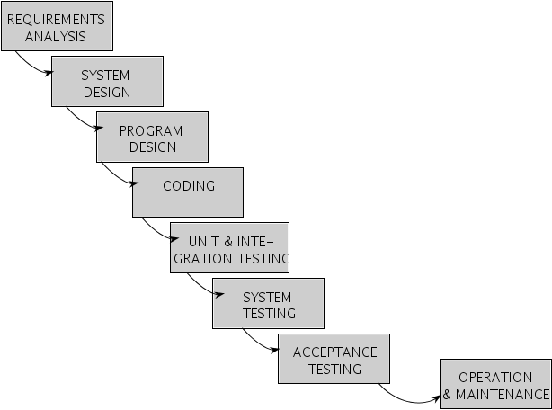
Waterfall Model
[Pfleeger 98]
NEU CS424 Software Engineering

Slide 17
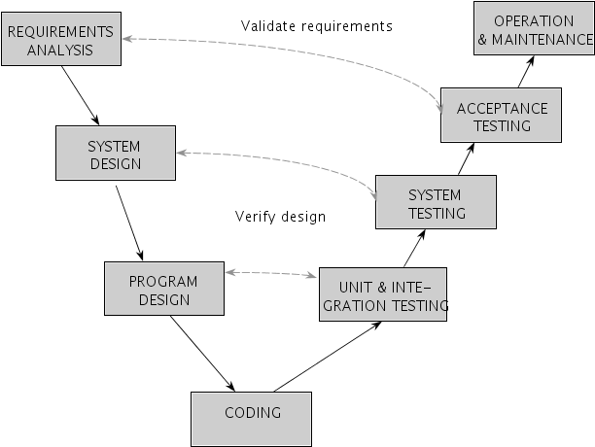
V Model
[Pfleeger 98]
NEU CS424 Software Engineering

Slide 18




Prototyping Model
Listen to
Customer
Build/Revise
Mock-Up
Customer
Test-drives
Mock-up
[Pressman 97]
NEU CS424 Software Engineering

Slide 19
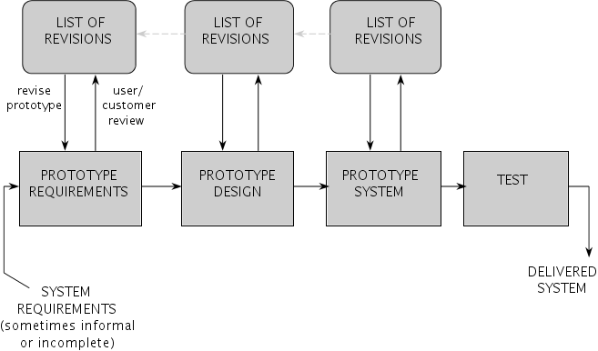
Prototyping Model
[Pfleeger 98]

Slide 20
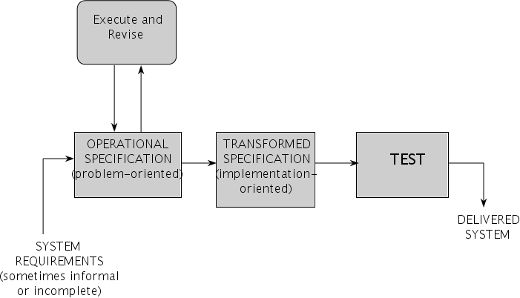
Operational Specification Model
[Pfleeger 98]

Slide 21















Boehm’s Spiral Model
DETERMINE GOALS,
EVALUATE ALTERNATIVES
ALTERNATIVES,
AND RISKS
CONSTRAINTS
4
Constraints
Risk analysis
4
3
Risk analysis
4
Constraints
3
Alternatives
3
2
Alternatives
Constraints
Risk analysis
2
2
Alternatives
Risk analysis
Constraints
Proto
-
Proto
-
Proto
1
-
Budget
Budget
Budget
Alternatives
Prototype
type
type
type
4
3
2
Budget
1
1
2
3
4
start
1
1
Requirements,
Concept of
Detailed
life-cycle plan
operation
Software
design
Software
design
requirements
Integration
Development
Validated
Code
and test plan
plan
requirements
Validated,
verified design
Unit test
[Pfleeger 98]
System
Implementation
Acceptance
test
PLAN
plan
test
DEVELOP AND TEST
NEU CS424 Software Engineering

Slide 22
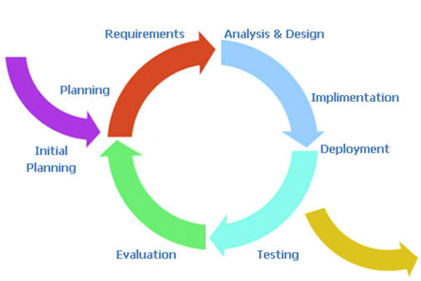
Iterative and Incremental Model

Slide 23
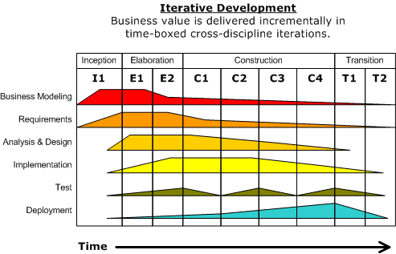
Unified Process Model
(time-boxed iterative UML Design)

Slide 24
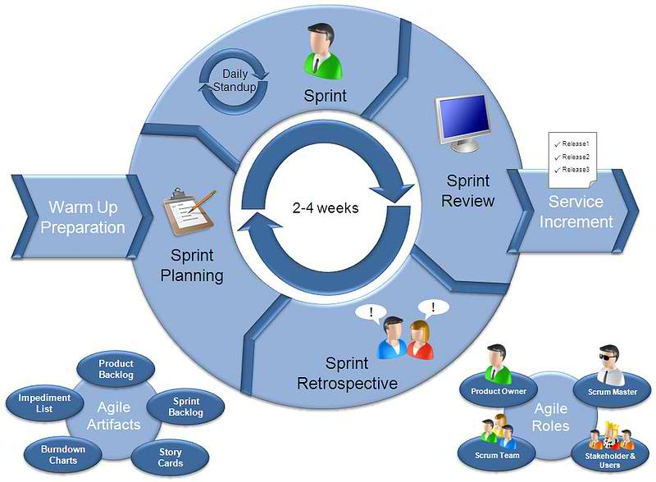
Agile Development Model
(light-weight iterative)

Slide 25
Agile Development Model
Three Types of Methods
Kanban
Scrum – most popular
Extreme Programming

